Slide 1


ER MODEL
Sai Vardhan T

Slide 2
Entity Relation Ship Model
The Entity-Relationship (ER) Model is a conceptual framework used to describe data relationships in a structured way.
Components of ER Model:
Entities
Attributes
Relationships
Cardinality

Slide 3
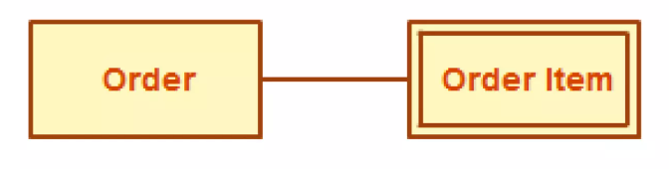
ENTITY
An entity represents a real-world object or concept that has a unique existence.
Entities are classified into:
Strong Entities: Exist independently (e.g., Customer, Student, Book).
Weak Entities: Depend on other entities for existence (e.g., Order_Item depends on Order).

Slide 4
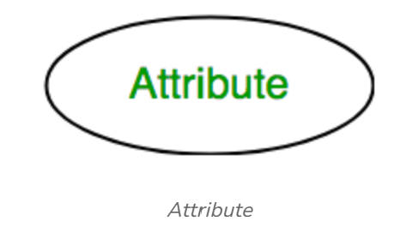
ATTRIBUTES
Attributes describe properties or characteristics of an entity.
Types of Attributes:
Simple (Atomic) Attributes: Cannot be divided further (e.g., Name, Age).

Slide 5
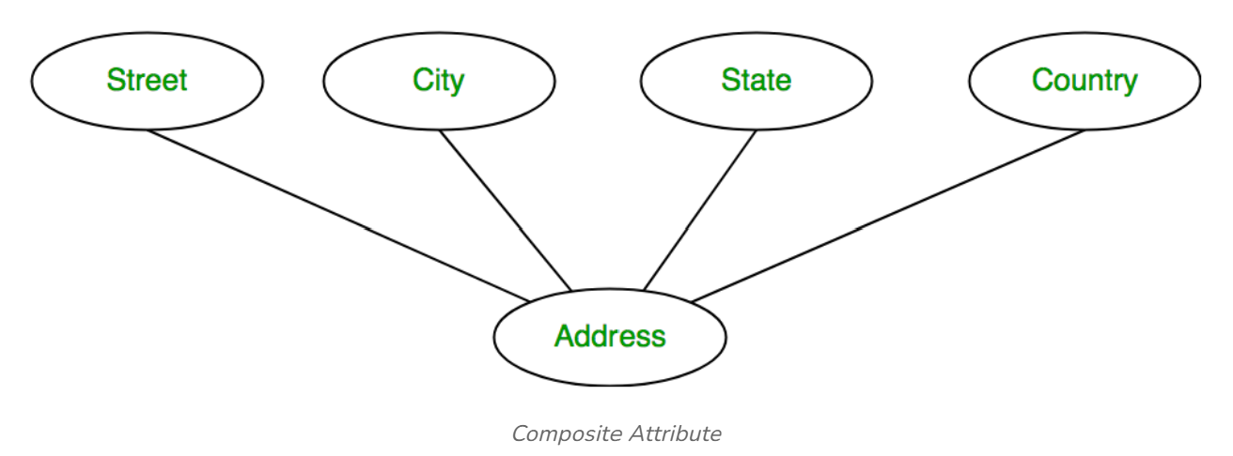
ATTRIBUTES
Composite Attribute: Can be broken down into sub-attributes (e.g., Address → Street, City, Zip).

Slide 6
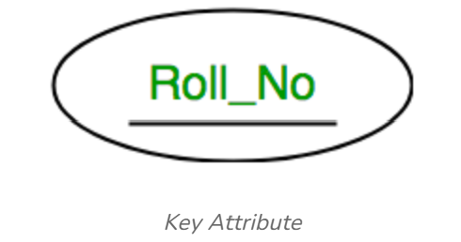
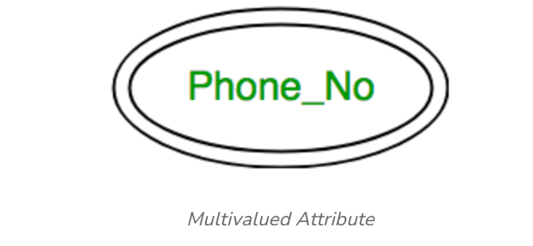
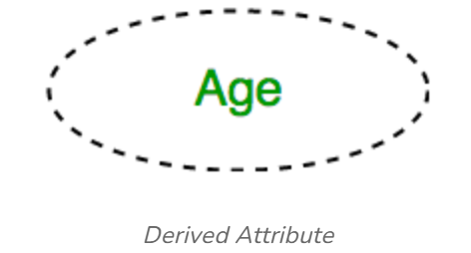
ATTRIBUTES
Key attribute: Uniquely identifies an entity (Primary Key).
Multivalued Attributes: Can have multiple values (e.g., Phone Numbers).
Derived Attributes: Calculated from other attributes (e.g., Age from Date of Birth).

Slide 7
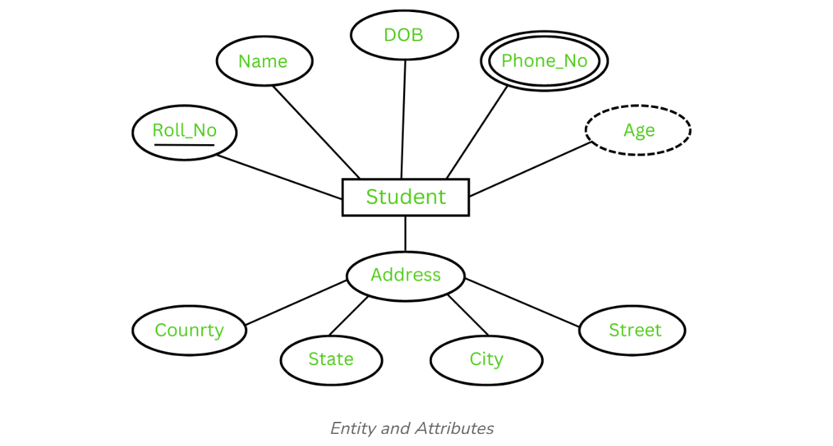
Entity and Attributes

Slide 8
RELATIONSHIPS
A relationship represents an association between two or more entities.
Types of Relationships:
One-to-One (1:1)
One-to-Many (1:M)
Many-to-Many (M:N)

Slide 9
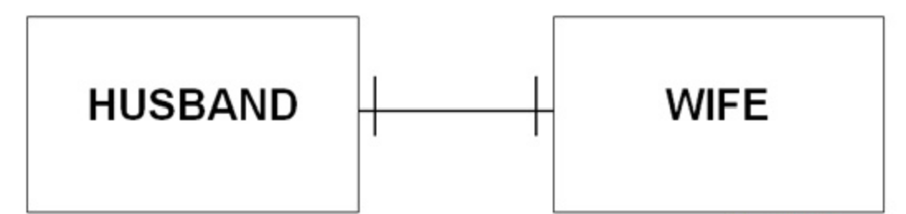
RELATIONSHIPS
One-to-One (1:1) → Each entity in A is related to one entity in B. (e.g., Country - President).
COUNTRY
PRESIDENT

Slide 10
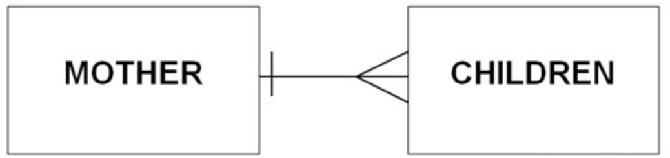
RELATIONSHIPS
One-to-Many (1:M) → One entity in A can relate to multiple entities in B. (e.g., Teacher - Students).
TEACHER
STUDENTS

Slide 11
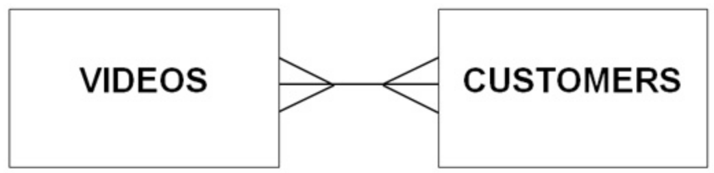
RELATIONSHIPS
Many-to-Many (M:N) → Multiple entities in A relate to multiple entities in B. (e.g., Students - Courses).
STUDENTS
COURSES

Slide 12
CARDINALITY
Cardinality defines the number of instances of an entity involved in a relationship.
Types:
1:1 (One-to-One)
1:M (One-to-Many)
M:N (Many-to-Many)

Slide 13
QUESTION
Generate an ER Diagram based on below scenario
Patients details will be provided with values
ID[PK], Name , Age and Visit Date
Test Reports will be provided with values
Name[PK], date and Result
Patient will Visit doctor where doctor with values
ID[PK], name and Specialization

